Slide 1

Faculty of Applied Engineering and Urban Planning
Civil Engineering Department
Dr. Eng. Mustafa Maher Al-tayeb
2 Semester 2022/2023
Probabilistic and Statistical

Slide 2
Chapter 5
(part 3)
Probability Distribution
Binomial
Probability
Distributions

Slide 3
Key Concept
This
section
presents a
basic definition
of a
binomial
distribution along with notation, and it presents methods for
finding probability values.
Binomial
probability
distributions
allow
us
to
deal
with
circumstances in which the outcomes belong to two relevant
categories such as acceptable/defective or survived/died.

Slide 4
Definitions
A binomial probability distribution results from a procedure that meets all the following requirements:
1. The procedure
has a fixed number of trials.
2.
The outcomes
of each trial must be independent of one
another.
3.
Each trial can
have only two outcomes or outcomes that
can be reduced to two outcomes. These outcomes can be
considered as either success or failure.
4.
The
probability
of
a success
remains
the
same
in
all
trials.

Slide 5
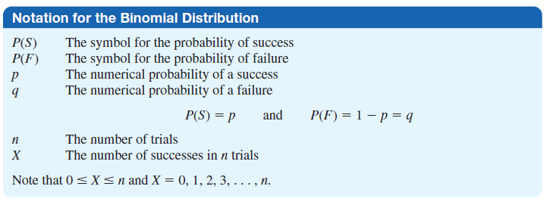
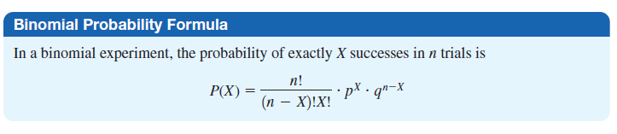

Slide 6
Methods for Finding Probabilities
Using the Binomial Probability Formula
P(x)=_{n} C_{x} ⋅
x = 0,1,2,...,n
p
x
⋅ q
n−x
where
n
x
p
q
=
=
=
=
number of trials
number of successes among n trials
probability of success in any one trial
probability of failure in any one trial (q =
1 – p)

Slide 7
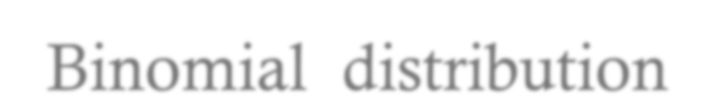
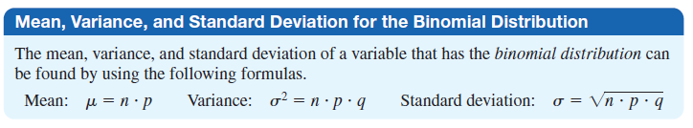
Binomial
distribution
Mean,
Variance
&
Standard
deviation

Slide 8
Ex.1
Use
the binomial
probability
formula
to find
the
probability of getting exactly 3 correct responses among 5
different requests from directory assistance. Assume
in general the responses is correct 90% of the time.
that
Solution:
That is Find P(3) given that n=5, x=3, p=0.9 & q=0.1
P(x)=_{n} C_{x}
x
n−x
⋅ p ⋅ q
P(3)= C ⋅
P³ ⋅ q⁵⁻³
5 3
P(3)= C ⋅ (0.9)³ ⋅ (0.1)⁵⁻³
= 10× 0.729× 0.01 =
0.0729
5 3

Slide 9
Ex.2 Consider the
If we let the event
experiment of flipping a coin 3 times.
of getting tails on a flip be considered the random variable T represents the
“success”,
and if
number
of
tails obtained,
then
, and
T
will
be
binomially
distributed
probability
with n=3
of exactly
,p=0.5
2 tails.
q=0.5
.
Calculate
the
Solution:
⎛
1
₂
⎞
⎛
1
1
1³
2
3
8
⎞
P(2) =
₃C₂
⎜ ⎟ ⎜ ⎟
= 3×
=
= .375
2
2
⎝ ⎠ ⎝ ⎠

Slide 10
Ex.3 Each sample of water has a 10% chance of containing
a particular organic pollutant. Assume that the samples are
independent with regard
Find the probability that
contain the pollutant.
to
in
the
the
presence of
the pollutant.
next
18
samples,
exactly
2
Solution:
Let
n=18,
x=2, p=0.1 & q=0.9
P( x )=_{n} C_{x}
x
n−x
⋅ P ⋅ q
P(3)=
C ⋅
P² ⋅ q¹⁶
18 2
P(3)=
C ⋅ (0.1)² ⋅ (0.9)¹⁶
18 2

Slide 11
Example 3 (cont.)
Also,
Find the probability that in the next 18 samples, that
contain the pollutant.
Let n=18, p=0.1 & q=0.9
3
or
4
P(3) + P(4)
=₁₈C₃
3
(18−3)
4
(18−4)
⋅ P ⋅ q
+₁₈C₄
⋅ P
⋅ q
Find mean & standard deviation
μ =
σ =
np = 18(0.1) = 1.8
np(1− p) =
1.8(1− 0.1) = 1.27

Slide 12

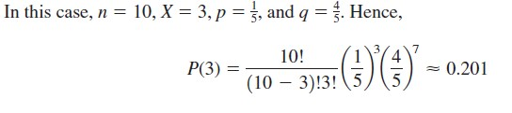
Ex.4 A survey found that one out of five Americans says
he or she has visited a doctor in any given month. If 10
people are selected at random, find the probability
that
exactly 3
will
have
visited
a
doctor
last
month.
Solution:

Slide 13
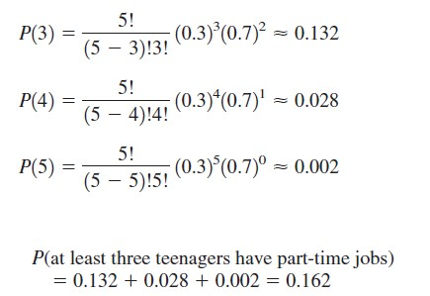
Ex.5 A survey from Teenage Research Unlimited (Northbrook,
Illinois) found that 30%
of teenage consumers receive their
spending
money
from
part-time
jobs.
If
5
at
teenagers
are
selected at random, find
the
probability
that
least
3
of
them
will have part-time
jobs.
Solution:

Slide 14
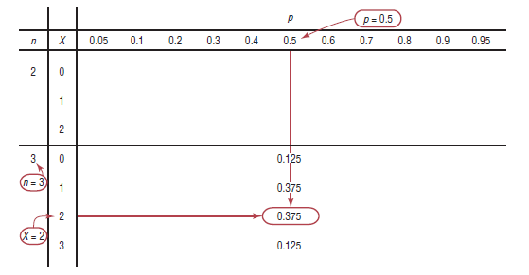
Using
table
to Calculate the Binomial
Probability
Table
B
in Appendix A

Slide 15
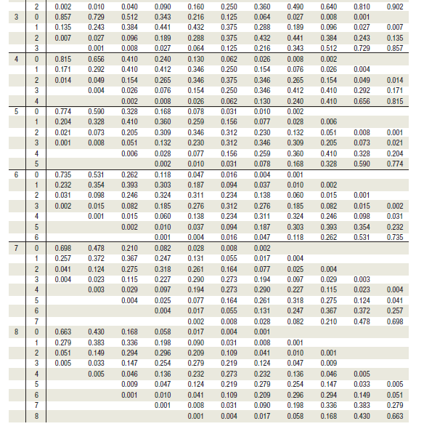

Slide 16

Ex.6 There is a 0.54 probability that a randomly selected
freshman at a two-year college will return the second year.
In
each
case,
assume
that 5
freshmen
at
the
a
two-year
college
are
randomly
selected
and
find
probability
indicated
• Find
return
• Find
return
the
for
the
for
the
probability
that at least four
of
the
freshmen
the second year
probability
that at
most
two
of
the
freshmen
the second year
probability that more than one of the
•
Find
freshmen
return
for the second year

Slide 17
Solution:
P(4) + P(5)
=₅ C₄ ⋅ 0.54
4
1
5
0
⋅ 0.46 +₅ C₅
⋅ 0.54
⋅ 0.46
P(0) +
P(1) + P(2)
P(2) + P(3) + P(4) +
P(5)

Slide 18
Ex.7
The
rate of
on-time
flights
for
commercial
jets
are
of rate
continuously
tracked
by
the
U.S.
Department
had the best
Transportation. Recently, Southwest Air
with 80%
conducted
of
by
its
flights
arriving
on
time.
A
test
is
randomly
selecting 15
southwest
flights
and observing
whether they arrive on time.
•
•
Find
Find
the
the
probability
probability
that exactly
that at least
10
10
flights
flights
arrive
arrive
on time
late

Slide 19
Chapter
Probability
5
(part 4)
Distributions

Slide 20
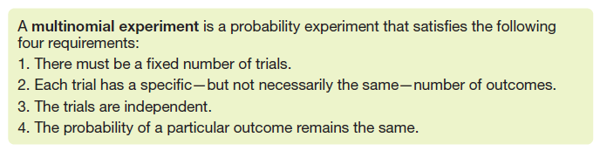
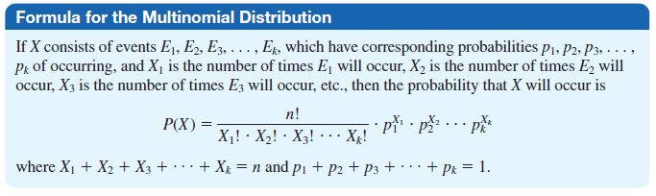
The Multinomial Distribution
3

Slide 21

Ex.1
30%
as a
In a large city, 50% of the people choose
choose dinner and a play, and 20% choose leisure activity. If a sample of 5 people is
a movie,
shopping randomly
selected, find the probability that 3 are
planning
mall.
to
go
to
a
movie, 1 to
a
play,
and
1
to
a
shopping
Solution:

Slide 22

Ex.2 A box contains 4 white balls, 3 red balls, and 3 blue
balls. A ball is selected at
random, and its color is written
time. Find the probability that if
down. It is
5 balls are
replaced
selected,
each
2
are
white,
2
are
red,
and
1
is
blue.
Solution:

